Slide 1
iterations in bash
Advanced Examples of Iterations (Loops) In Bash Script

Slide 2
PROBLEM A
Use the FOR loop in Bash to write a program without a list and read command-line arguments.
We can use the FOR loop without any list/command output/array.
We use the $stp variable for finding the step of the loop.
Each step will increment the value of $stp by 1.
When the $stp is 1, the script will print the message “I like chocolates”
When the $stp is 2, the script will print the message “My favorite color is ”
When the $stp is 3, the script will print the message “I love Git Bash”
do indicates the start of the loop
echo $stp is used to display the value which is stored in the stp variable.
; will terminate the echo statement.
done will indicate the end of the loop.
The command-line arguments to run the script are $ bash problem1.sh Chocolates red Git Bash

Slide 3
PROBLEM A PSEUDOCODE
The following code will use the FOR command to create a program without a list
The following code will use the FOR command to create a program without a list
Define a variable stp=1
for text
do
if stp is equal to 2 then disp="My favorite color is " elif stp is equal to 3 then disp="I love " else disp="I like " fi Print the result "$disp $text"
Increment the variable stp by 1 using the + operator
done

Slide 4
PROBLEM A FLOWCHART AND SCRIPT
stp=1
for text
do
if [ $stp -eq 2 ]
then
disp="My favorite color is "
elif [ $stp -eq 3 ]
then
disp="I love "
else
disp="I like "
fi
echo "$disp $text"
((stp=$stp+1))
done

Slide 5

PROBLEM A OUTPUT

Slide 6
PROBLEM B
Use the infinite FOR loop to display a five lists menu and display a specific message for each number (5 to exit).
We use the infinite FOR loop to perform repetitive tasks multiple times.
The loop terminates when a particular condition appears.
We will not define a termination condition in this loop.
The loop will display a menu for 5 lists until the user presses the number 5.
For other numbers, the program will display a specific message (from 1 to 4).
After that, it will display the menu again.
The empty for expression (( ; ; )) is used to define an infinite loop.
Since we are using the case command inside an infinite loop in this example, we will use the exit command to terminate the loop.

Slide 7
PROBLEM B PSEUDOCODE
The following code will use the FOR command to create a program to allow the user to choose from 1 to 5 and display different results.
define the infinite FOR loop
do
Print the message "1. Print the success message."
Print the message "2. Print the information message."
Print the message "3. Print the Warning message."
Print the message "4. print the error message."
Print the message "5. To Exit"
Take the input from the user
define the case expression, followed by the “in” keyword
Print the result "The Task is Successfully completed.";;
2) Print the result "It is an Invalid input";; 3) Print the result "Your computer is running on low battery";; 4) Print the result "You submitted a Wrong number of arguments ";; 5) exit 0;; *) print the result “Wrong selection";; terminate the case statement using “esac” done

Slide 8
PROBLEM B FLOWCHART AND SCRIPT
for (( ; ; ))
do
echo "1. Print the success message"
echo "2. Print the information message"
echo "3. Print the Warning message"
echo "4. print the error message"
echo "5. To Exit"
echo -n "Select a number from [1-5]:"
read ans
case "$ans" in
1) echo "The Task is Successfully completed." ;;
2) echo "It is an Invalid input";;
3) echo "Your computer is running on low battery";;
4) echo "You submitted a Wrong number of arguments ";;
5) exit 0;;
*) echo "Wrong selection";;
esac
done

Slide 9
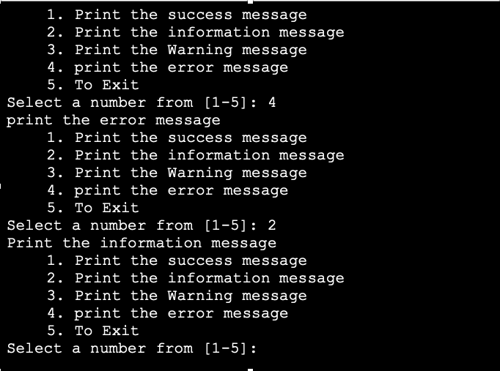
PROBLEM B OUTPUT

Slide 10
PROBLEM C
Use the CONTINUE statement in the WHILE loop to display a set of 5 numbers and omit the third step.
In this program we will use the CONTINUE statement in the WHILE loop.
The program will iterate 5 times without printing all of the 5 positions.
We will define the condition [ $i -le 5 ] inside the WHILE loop.
The program will check the condition [ $i -le 5 ] before executing the commands.
The program will execute the commands between do and done for as long as the condition [ $i -le 5 ] is true.
We will use the CONTINUE statement in the third position. Thus, the loop will skip the text of third position and continue to the next iteration.
We will define the expression inside the if..then..fi statement within the WHILE loop.
If the expression is true; [ $i == 3 ], the loop will execute the CONTINUE statement and omit the third step.
If the expression is false then the program will continue to the next iteration.

Slide 11
PROBLEM C PSEUDOCODE
The following program will use the CONTINUE statement in the WHILE loop to display a set of 5 numbers and omit the third step.
Assign the value to the variable i
while i is less than equal to 5
do
increment the value of i using the ++ operator
if i is equal to 3
then
continue
fi
Print the result "Value of i: $i"
done

Slide 12
PROBLEM C FLOWCHART

Slide 13
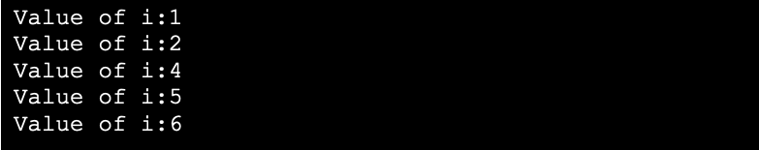
PROBLEM C SCRIPT AND OUTPUT
i=0
while [ $i -le 5 ]
do
(( i++ ))
if [ $i == 3 ]
then
continue
fi
echo "Value of i : $i"
done

Slide 14
PROBLEM D
Use a variable in the UNTIL loop to decrement a number initialized at ten until it reaches the value 5.
In this program, we will use the $var variable for controlling the iteration of the loop.
We will initialize the loop at 10.
The loop will carry on the iteration six times.
We use the $echo command for printing the value of $var after each step.
To reach the UNTIL loop's termination condition, the value of $var will decrement by 1 in each step.
We will define the condition [ $var – lt 5 ] inside the UNTIL loop.
The loop will check this condition before executing the commands.
It will only execute the commands if the condition evaluates to false.
The loop will get terminated when the condition evaluates to true (the value reaches less than 5 in this case).

Slide 15
PROBLEM D PSEUDOCODE
The following program will use counter in the UNTIL loop to decrement the value of a number 6 times.
Initialize the value of the variable var=10
until var is less than 5
do
Print the result "The current value of the variable = $var"
decrement the value of var by using the -- operator
done

Slide 16
PROBLEM D FLOWCHART

Slide 17
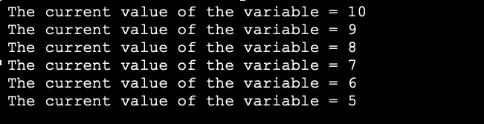
PROBLEM D SCRIPT AND OUTPUT
var=10
until [ $var -lt 5 ]
do
echo "The current value of the variable = $var"
((var--))
done

Slide 18
SUMMARY
In this chapter, we looked at four advanced examples of iterations in Bash which will help students get a better understanding of the way the iterations function in Bash.
Each example contains detailed explanation, along with flowcharts, pseudocodes, scripts and outputs.
The examples offer an in-depth analysis of the FOR, WHILE and UNTIL loops used in Bash scripting.
Students can gain confidence in writing their first code by going through these examples.

